Slide 1
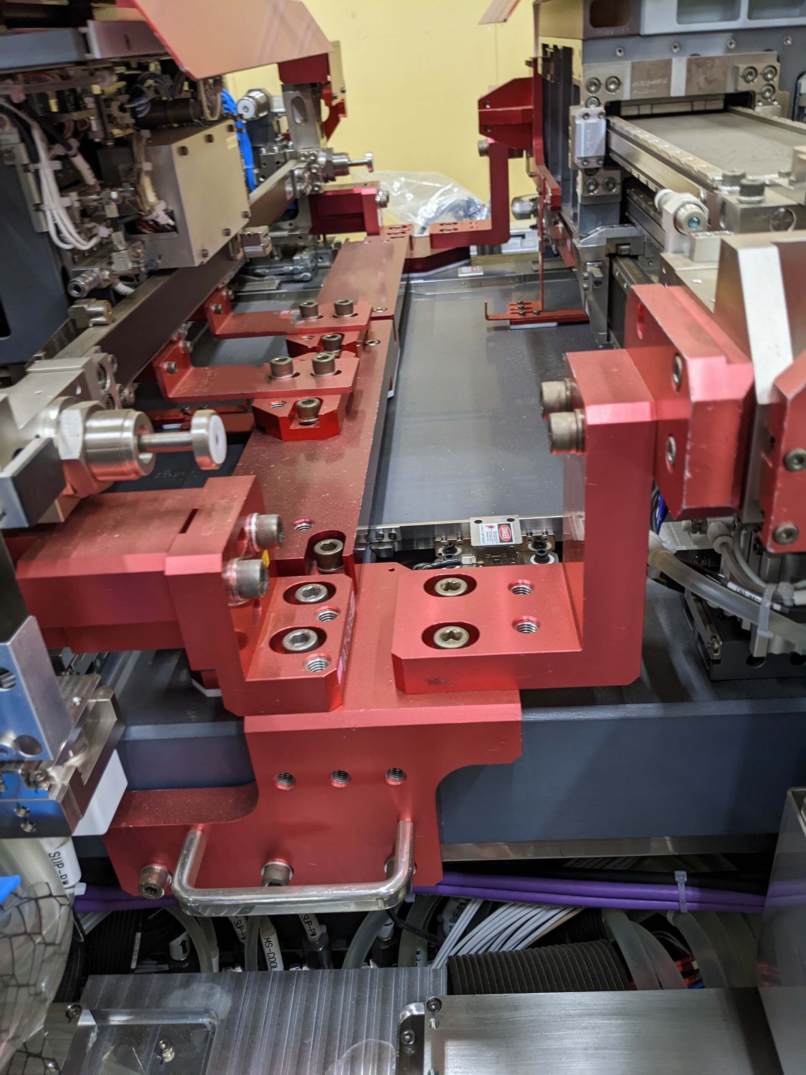
Y fine Halbach Array
Y fine coils
Z magnets?
Z coils?

Slide 2
